Slide 2
Objectives
Understand that a computer needs a network interface card (NIC) to access a network
Describe the role of a router in a network including:
The routing of packets
IP address assignment
Connecting local networks to the internet

Slide 3
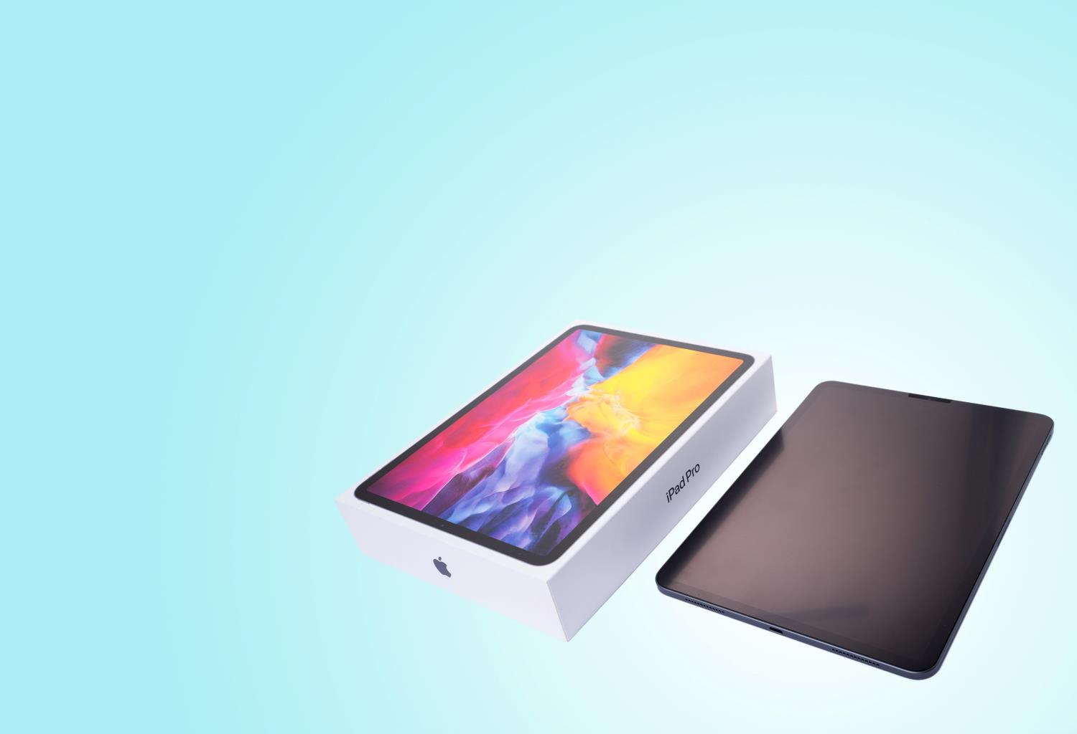

Starter
When a tablet is first unboxed it cannot use the Internet or home network
What hardware is used in connecting the tablet to the Internet?

Slide 4
Starter
Key hardware:
The tablet contains a Network Interface Card (NIC)
The tablet connects to a router which contains a wireless access point (Wi-Fi)

Slide 5
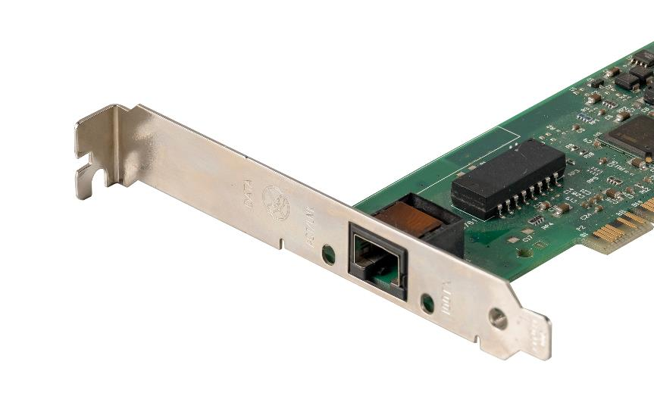
Network interface card (NIC)
Every device that connects to a network requires a network interface card (NIC)
In larger computers this may be a large card as shown
More commonly, it is built into the motherboard
A NIC is also required on any smartphone or tablet

Slide 6
IP addresses
When computers connect to networks they each have a unique address, just like each house in the UK has an address
Each address has a 32-bit number
It is usually written in denary with a dot separating each byte
The address allows data to be sent to the correct computer
192
.
168
.
1
.
57
11000000 . 10101000 . 00000001 . 00111001
32-bit address

Slide 7
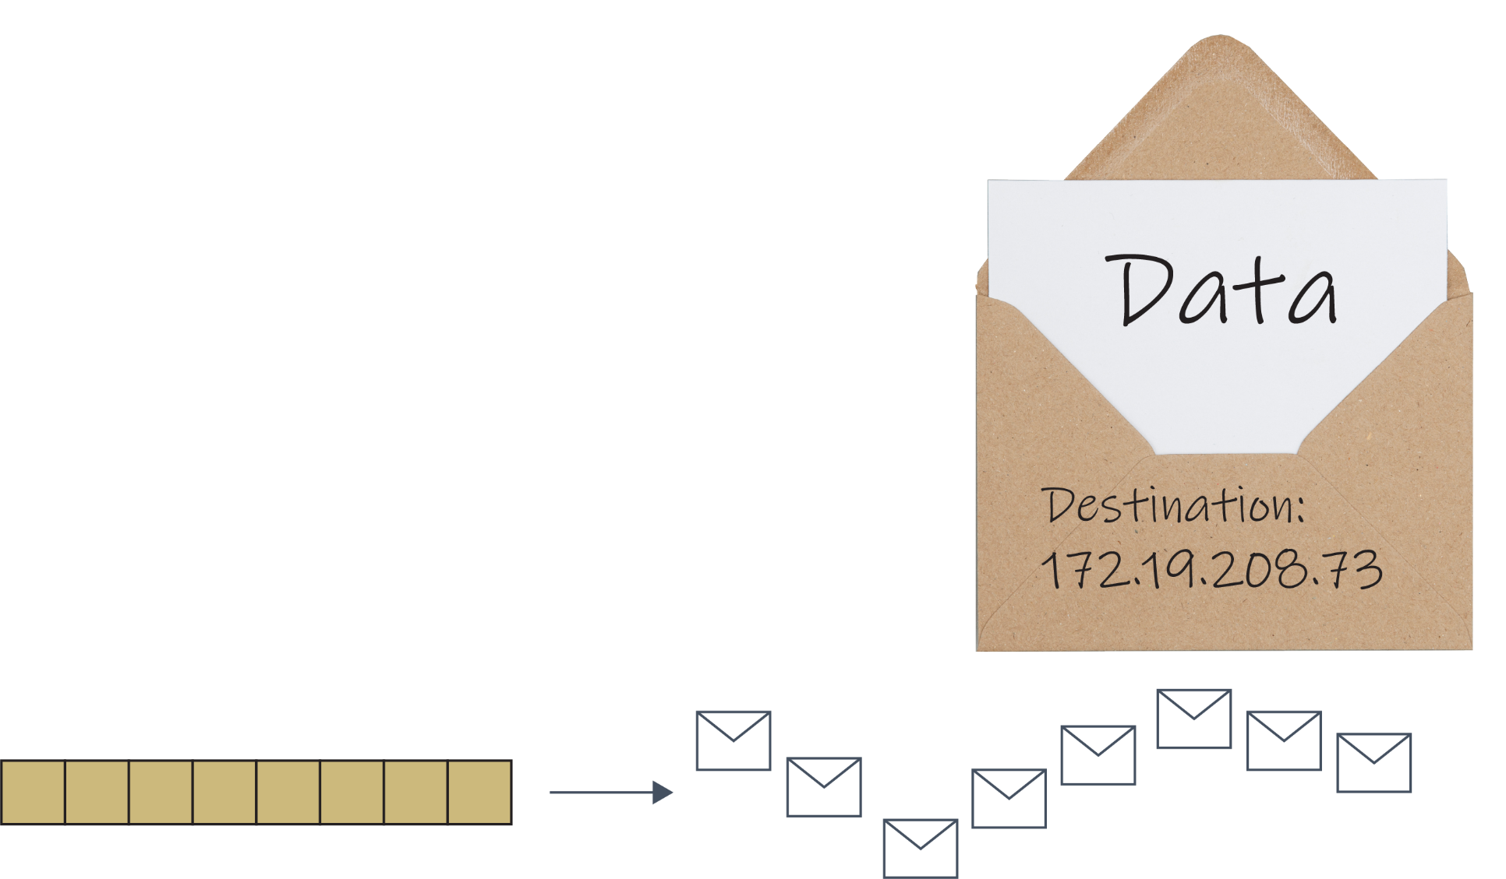
Data packets
When data is sent through the Internet or a TCP/IP network, it is split up into much smaller quantities known as data packets
These packets each store a small amount of the data
Each packet may take a different route through the network
Data
Data
Data packets

Slide 8
Worksheet 1
Complete Task 1 on Worksheet 1

Slide 9
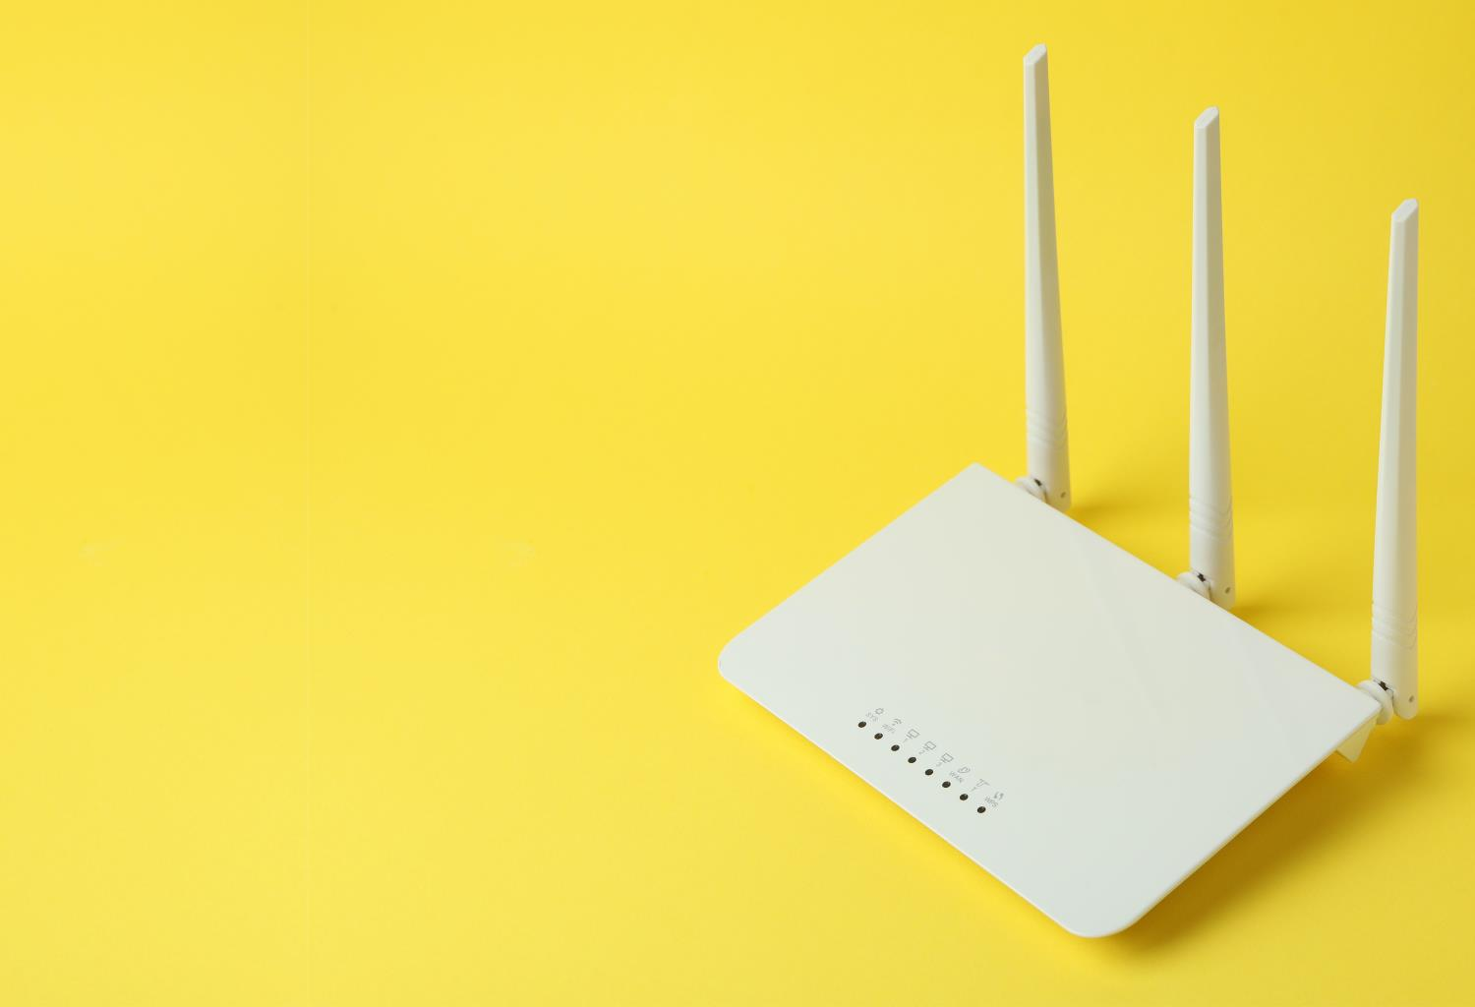
Router
Routers are used to send data to a specific destination on a network
A home router, also known as a hub, will route packets from one part of a network to another
What else might a typical home router/hub do?

Slide 10
Router
The home router will route packets. It also:
Contains a wireless access point for Wi-Fi connections
Connects the local network to the internet using a modem
Assigns IP addresses to each computer that connects to it

Slide 11
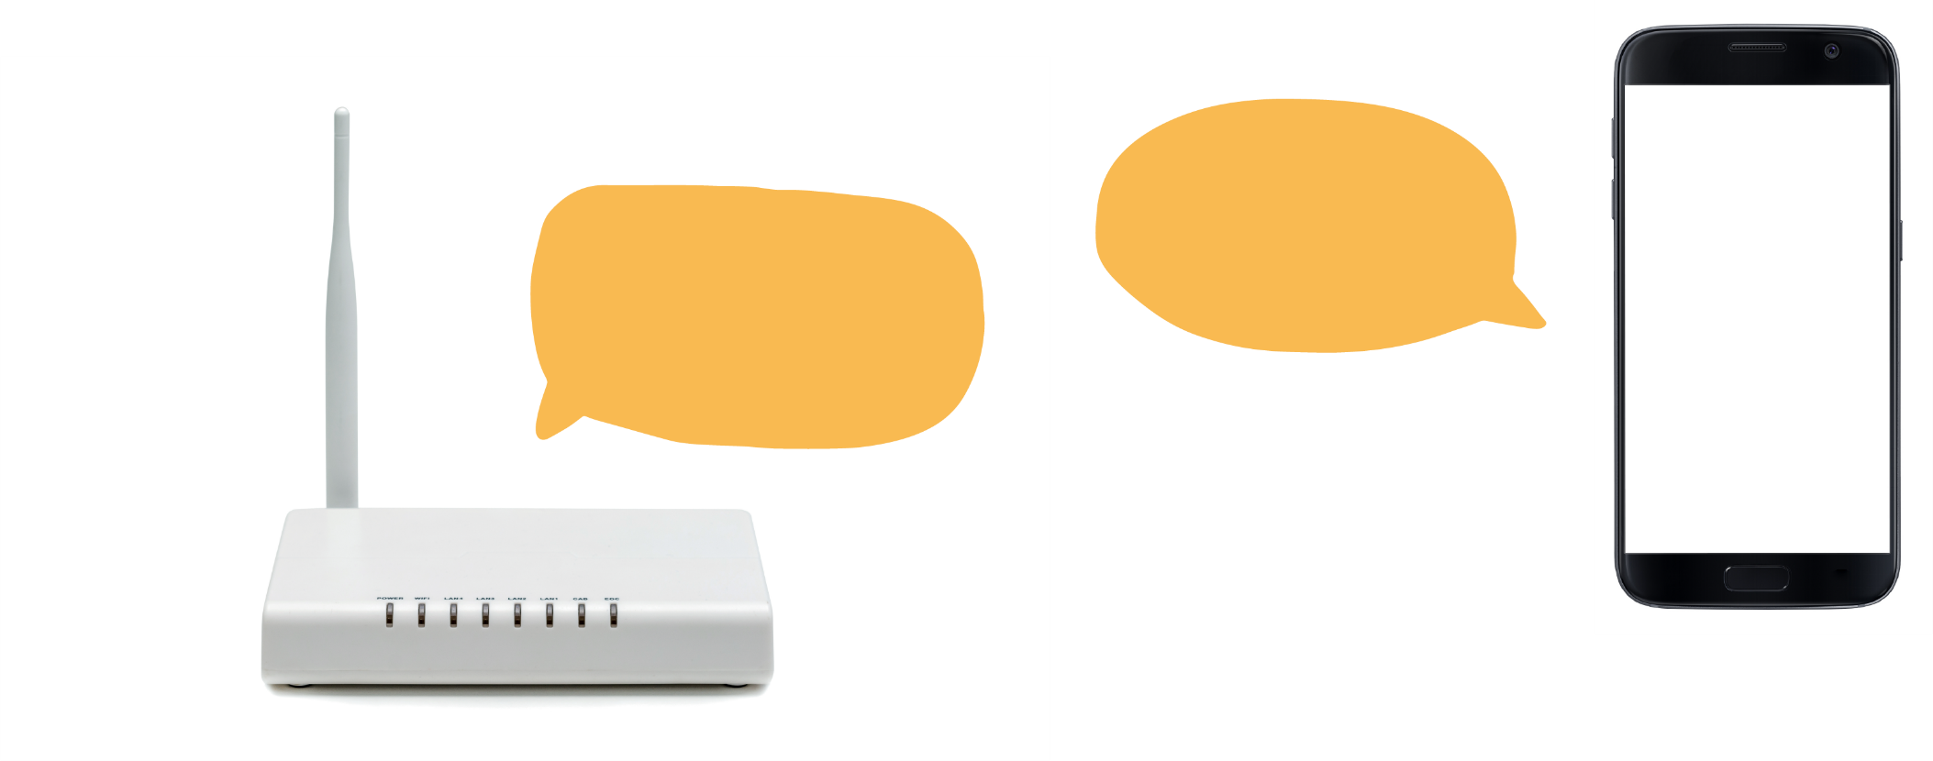
IP address assignment
A DHCP server (Dynamic Host Configuration Protocol) is built to home routers
When a new device connects to the network it is assigned an IP address by the DHCP server
2.
Yes please
1. Do you want to be 192.168.1.5 ?
3. Smartphone IP address: 192.168.1.5

Slide 12
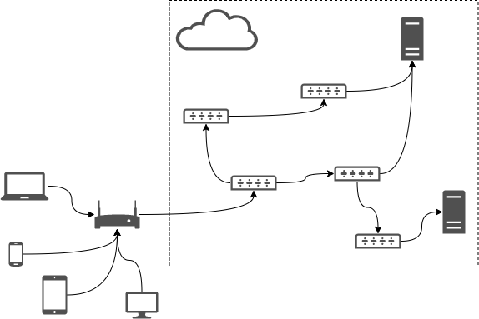
Connecting to the Internet
A router is used to connect a network to the Internet
In a home network, the router is combined with the modem, switch, wireless access point and firewall
In a large business, the router is likely to be a dedicated item of hardware
The computers and devices will then connect to dedicated switches or wireless access points
Internet

Slide 13
Worksheet 1
Complete Task 2 on Worksheet 1

Slide 14
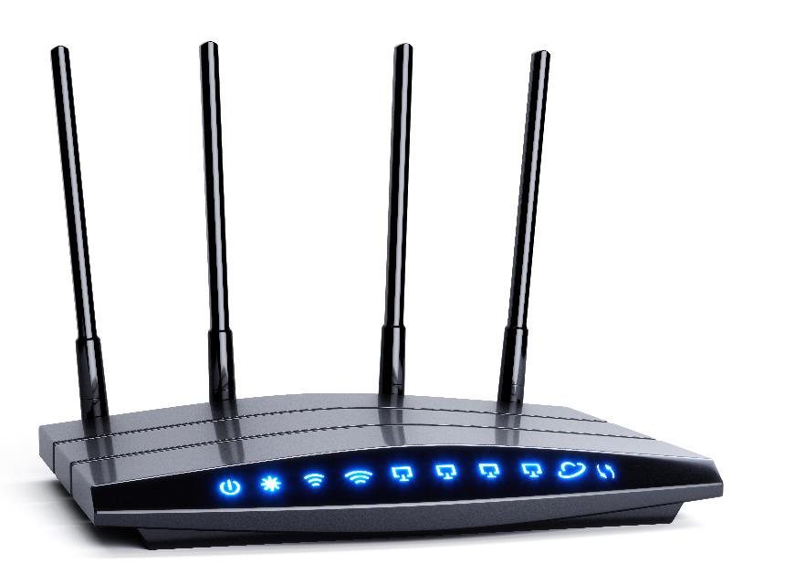
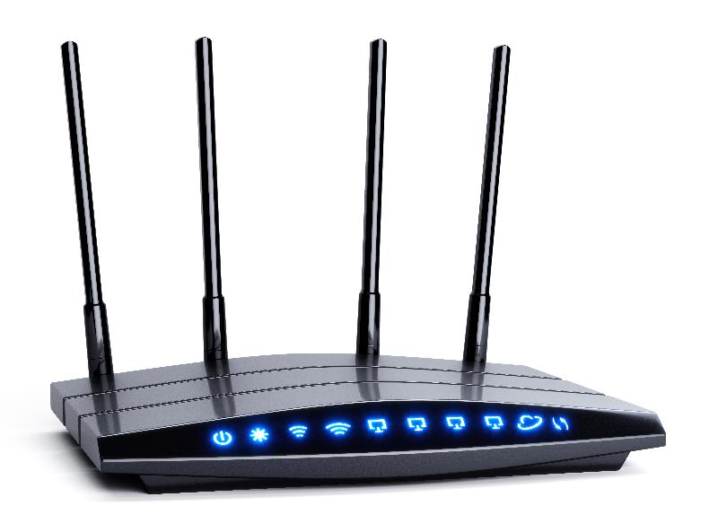
Plenary
Work with a partner to create a list of at least two items of hardware that are used to connect devices to the Internet
For each item of hardware, describe to your partner what it does

Slide 15
Plenary
Item of hardware | Purpose
Network interface card (NIC) | Inside each computer or device to connect it to the network
Router, which contains: Router Wireless access point Modem | The router sends data to a specific destination on a network; It assigns IP addresses if it contains a DHCP server; It connects the private/local network to the Internet The wireless access point may be inbuilt to the router – it allows devices to connect wirelessly A modem will be part of a home router – it converts data from digital to analogue (radio or optical)

